Slide 1
Research Integrity:
Principles and Practices for Responsible Research
2
Giovanbattista Califano, PhD
giovanbattista.califano@unina.it
https://califano.xyz/ri

Slide 2
Principles (ALLEA, 2023)
Reliability in ensuring the quality of research, reflected in the design, methodology, analysis, and use of resources.
Honesty in developing, undertaking, reviewing, reporting, and communicating research in a transparent, fair, full, and unbiased way.
Respect for colleagues, research participants, research subjects, society, ecosystems, cultural heritage, and the environment.
Accountability for the research from idea to publication, for its manage­ment and organisation, for training, supervision, and mentoring, and for its wider societal impacts.

Slide 3
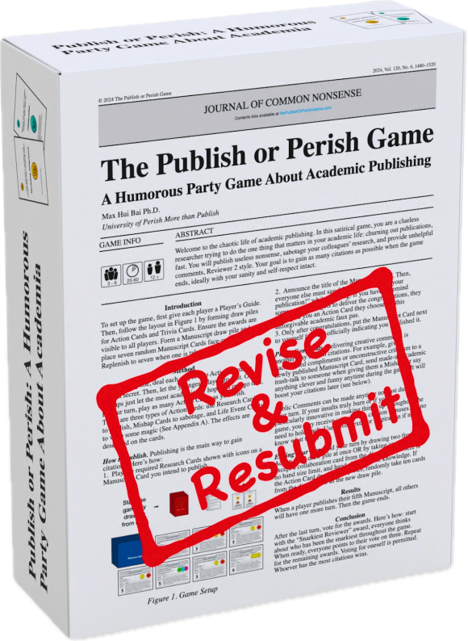
Good Research Practices (ALLEA, 2023)
1. Research Environment
If the environment rewards shortcuts, shortcuts will happen.

Slide 4


Good Research Practices (ALLEA, 2023)
1. Research Environment
Look for clear policies/procedures and use them early (don’t wait for a crisis).
Protect independence: push back on “must be significant by Friday” pressures.
Build reproducibility infrastructure: shared storage, versioning, traceable workflows.
Normalise “everyone does it” rationalisations under deadlines.
Stay silent when threats/retaliation dynamics appear (especially for early-career).

Slide 5
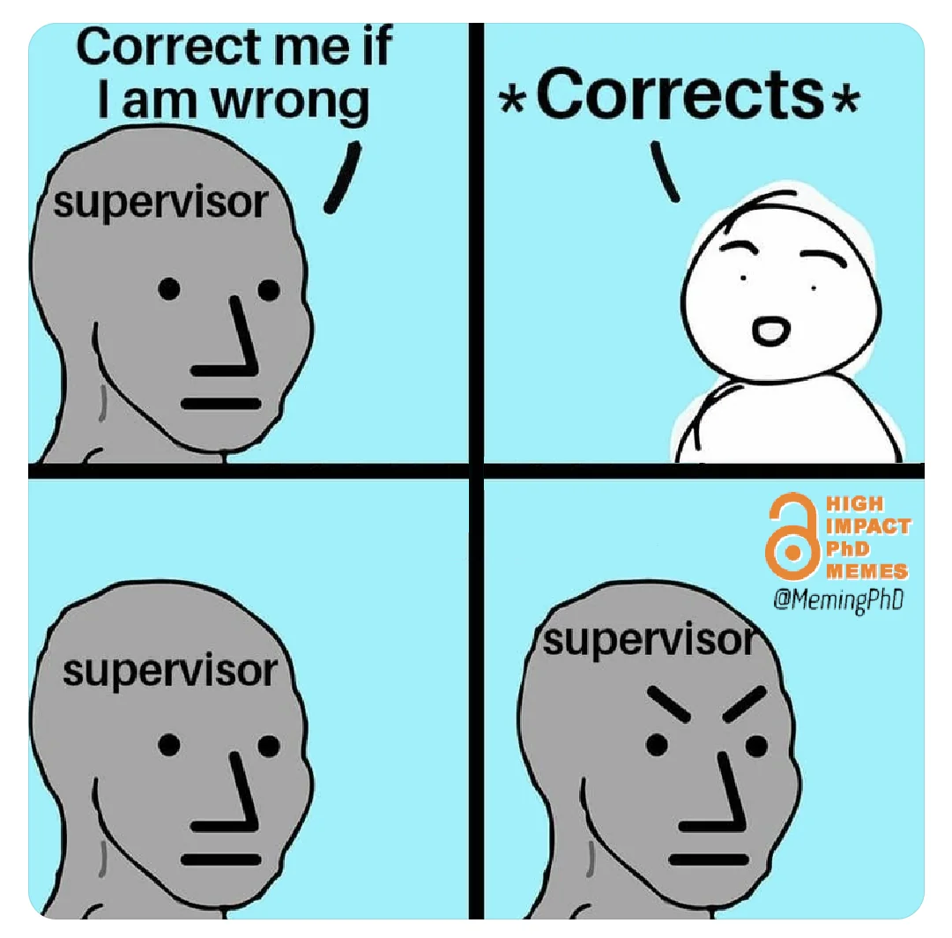
Good Research Practices (ALLEA, 2023)
2. Training, Supervision, and Mentoring
Training isn’t optional; it’s part of research quality control.

Slide 6
Good Research Practices (ALLEA, 2023)
2. Training, Supervision, and Mentoring
Treat design/methods/analysis/reporting as skills to be trained, not assumed.
Ask supervisors for explicit guidance (roles, expectations, feedback cadence).
Keep learning integrity norms throughout your career stage (yes, even seniors).
Assume “I’m a PhD so I must already know ethics/reproducibility”.
Let supervision be vague (“just figure it out”) when stakes are high.

Slide 7
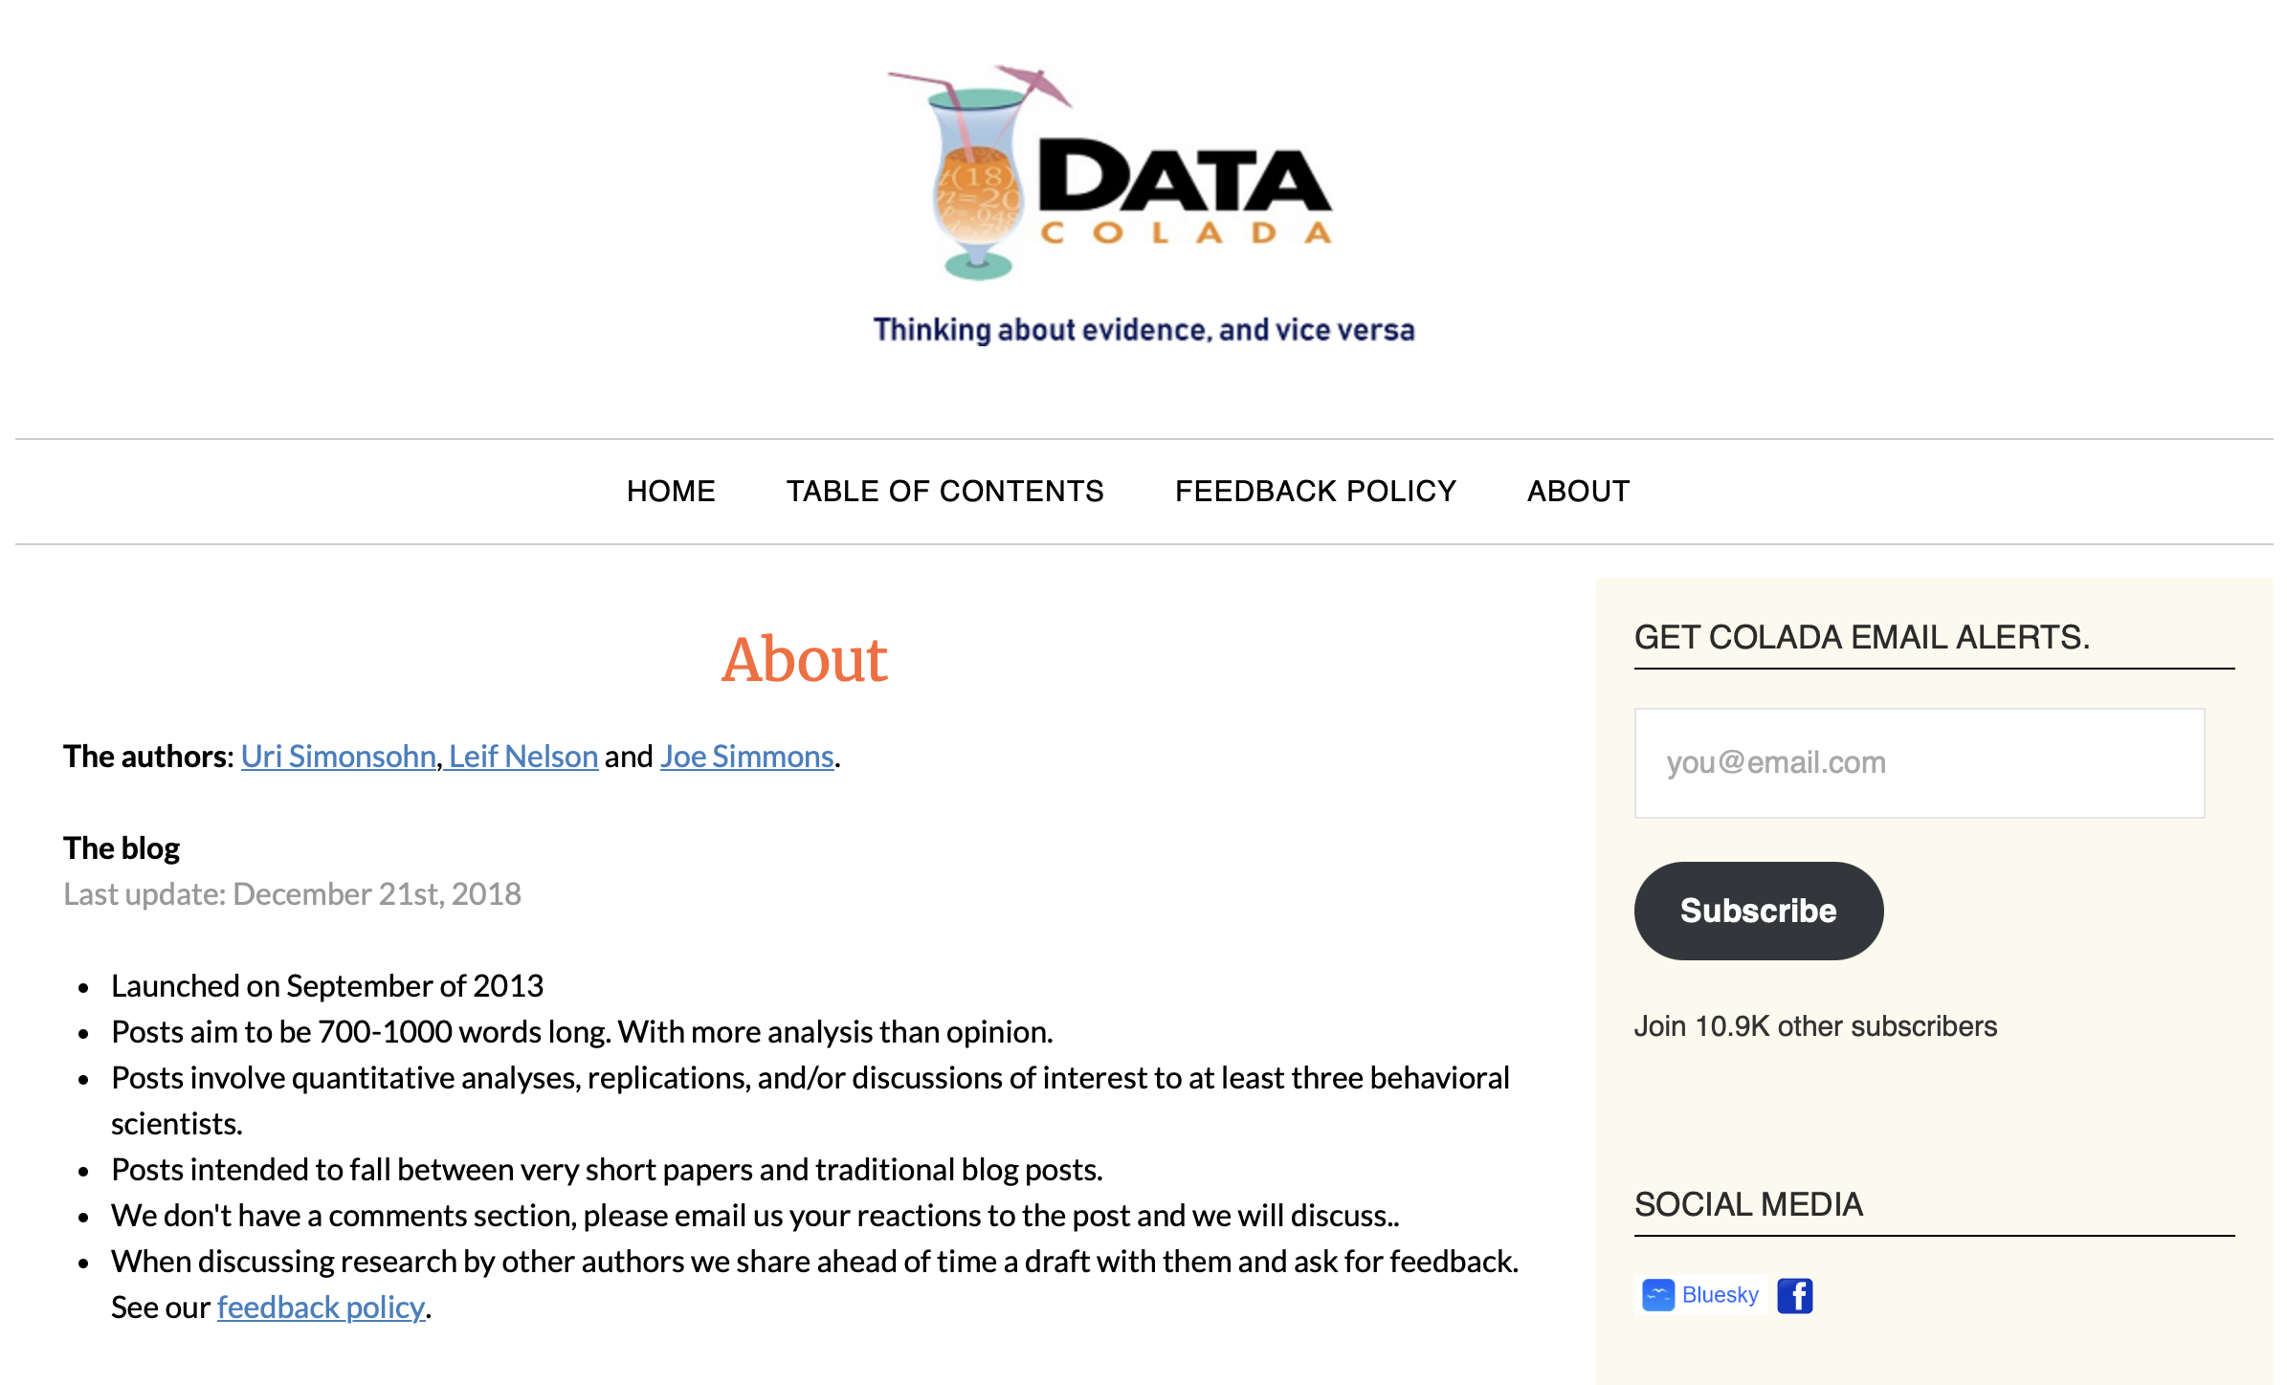
www.datacolada.org

Slide 8
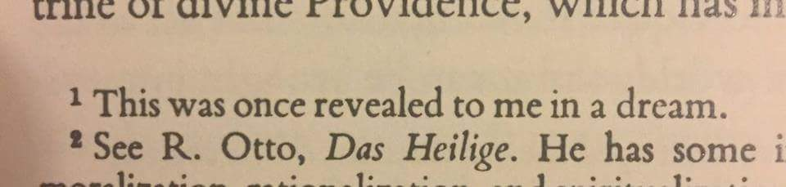
Good Research Practices (ALLEA, 2023)
3. Research Procedures
If you can’t explain it, you can’t defend it.

Slide 9
Good Research Practices (ALLEA, 2023)
3. Research Procedures
Design/carry out/analyse/document carefully and transparently.
Report methods/results in a way that enables verification/replication (where applicable).
Disclose external services / AI / automated tools used in methods or drafting.
“We tried a few approaches and reported the best” without documenting the path.
Hide tool use (AI, contractors, automated pipelines) if it affects the work.

Slide 10

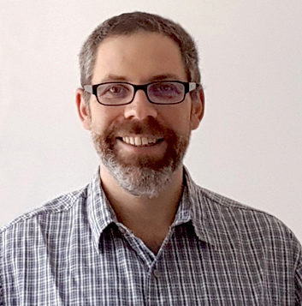

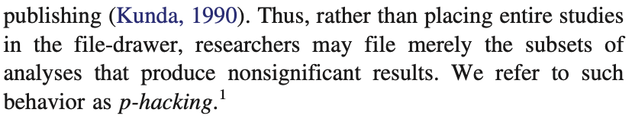
The Datacolada founders coined the term “p-hacking” in a 2014 paper (https://doi.org/10.1037/a0033242)
Joe Simmons
Uri Simonsohn
Leif Nelson

Slide 11
Some Examples
Data collection and stopping rules (“optional stopping”)
Peeking and stopping early once p drops below 0.05.
Continuing to collect more data until p becomes significant.
Changing the planned sample size after seeing interim results (without a pre-specified sequential plan).
Dropping planned waves/cohorts because they “mess up the result”.
Running multiple pilot samples and only treating the successful one as the “real” study.
Recruiting extra participants only in one condition to fix imbalance that harms significance.
Stopping recruitment when the effect flips direction to the desired one.

Slide 12
Some Examples
B) Outcome switching and choosing the “right” dependent variable
Measuring many outcomes but only reporting the significant ones.
Switching primary and secondary outcomes after seeing results.
Creating a new composite outcome post hoc because it yields significance.
Reporting one subscale of a questionnaire because the total score isn’t significant.
Trying multiple transformations of the outcome (raw, log, rank, z-score) and reporting whichever “works”.
Testing multiple time points and reporting only the significant one (e.g., day 7 not day 14).
Trying multiple windows/definitions (e.g., 0–24h vs 0–48h) and keeping the significant one.

Slide 13
Some Examples
C) Predictor and model specification fishing
Trying the predictor as continuous vs categorical and choosing the significant version.
Fitting many model forms: linear, quadratic, spline, etc., and reporting the winner.
Adding/removing covariates until p < 0.05 (“covariate shopping”).
Controlling for post-treatment variables because it makes the treatment effect significant.
Trying multiple interaction terms and only reporting the significant interaction.

Slide 14
Some Examples
D) Subgroup and “slice-and-dice” analysis
Testing many subgroups (gender, age bands, countries, etc.) and highlighting the significant one.
Defining subgroups after seeing where the effect is strongest.
Dropping “outlier” groups (sites, labs, schools) because they weaken significance.
Searching for significance in region × condition or time × condition combinations.
Reporting subgroup effects without correcting for multiple comparisons.

Slide 15
Some Examples
E) Data cleaning and exclusion choices (“researcher degrees of freedom”)
Trying different outlier rules (±2 SD, ±3 SD, Cook’s D, winsorizing) until significant.
Excluding participants for “failed attention checks” using multiple thresholds and picking the one that helps.
Choosing among different data filters (e.g., remove weekends, remove holidays) until it works.
Reclassifying borderline cases across categories to achieve significance.

Slide 16
Some Examples
F) Multiple testing without proper correction
Running lots of hypothesis tests and not adjusting for multiplicity (or only adjusting when it hurts less).
Testing many correlations and only reporting the significant ones.
Trying many mediation paths and reporting only the significant indirect effect.
Running many ANOVAs/t-tests across variables and only reporting the winners.
Selectively reporting only “planned comparisons” after the fact.

Slide 17
Some Examples
G) Selective reporting and “beautifying” the results
Reporting the analysis that gives the smallest p and calling it the “main” analysis.
Moving non-significant results to the supplement or omitting them entirely.
Presenting exploratory results as if they were confirmatory (HARKing + p-hacking combo).
Reporting one-tailed tests because it becomes significant (without pre-specification).
Switching between parametric and nonparametric tests depending on which is significant.
Choosing between one-sided vs two-sided CI/hypothesis tests post hoc.
Rounding p values or reporting “p < 0.05” strategically to obscure near-misses.

Slide 18
Some Examples
H) Design and measurement flexibility
Trying multiple versions of a manipulation and reporting the one that “worked”.
Picking among multiple sensors/metrics (e.g., HRV measures) after seeing which correlates.
Graphical and summary choices that hide the fishing
Showing only the plot that looks clean (after trying several transformations).
Choosing axis ranges/bin widths that visually amplify the “significant” pattern.
Reporting only summary stats that favor the effect (e.g., means not medians) after checking both.

Slide 19
P-hacking is inevitable whenever:
a researcher hopes to find evidence for a particular result,
there is ambiguity about how exactly to analyze the data, and
the researcher does not perfectly plan out their analysis in advance.
Although some mistakenly believe that accusations of p-hacking are tantamount to accusations of cheating, the truth is that accusations of p-hacking are nothing more than accusations of imperfect planning. The best way to address the problem of imperfect planning is to plan more perfectly:
PREREGISTER
YOUR STUDIES

Slide 20
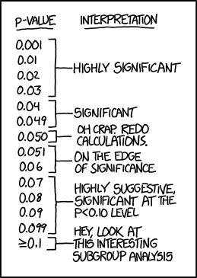
Preregistrations are time-stamped documents in which researchers specify exactly how they plan to collect their data and to conduct their key confirmatory analyses.
The goal of a preregistration is to make it easy to distinguish between planned, confirmatory analyses – those for which statistical significance is meaningful – and unplanned exploratory analyses – those for which statistical significance is not meaningful.
Because a good preregistration prevents researchers from p-hacking, it also protects them from suspicions of p-hacking .
from XKCD

Slide 21
How to (properly) preregister your study
Choose a platform to host your preregistration
The two major options are OSF and AsPredicted. I recommend the latter because it’s more straightforward
Preregister your study before collecting data and conducting analyses (not always obvious, apparently)
Specify exactly how the key confirmatory analyses will be conducted
The preregistration should be concise and easy to read

Slide 22
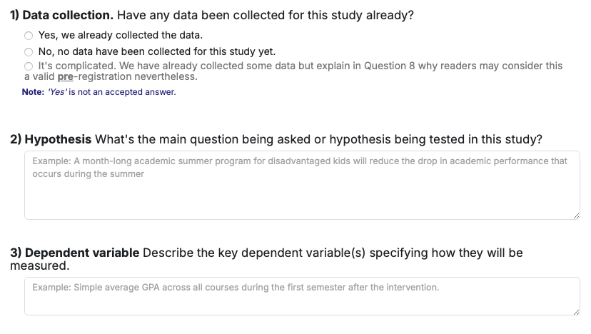
Example for https://aspredicted.org (1/4)

Slide 23
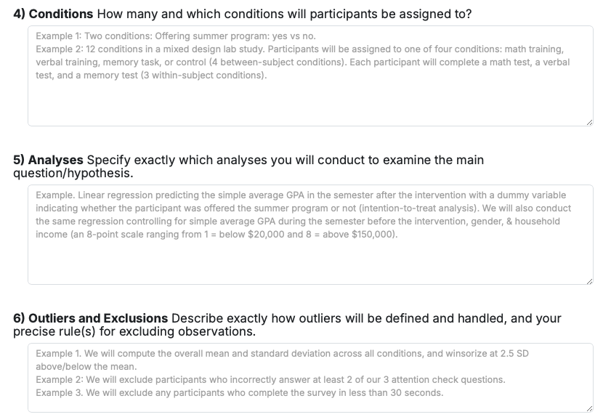
Example for https://aspredicted.org (2/4)

Slide 24
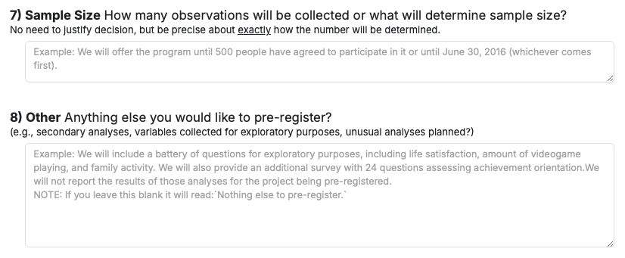
Example for https://aspredicted.org (3/4)

Slide 25
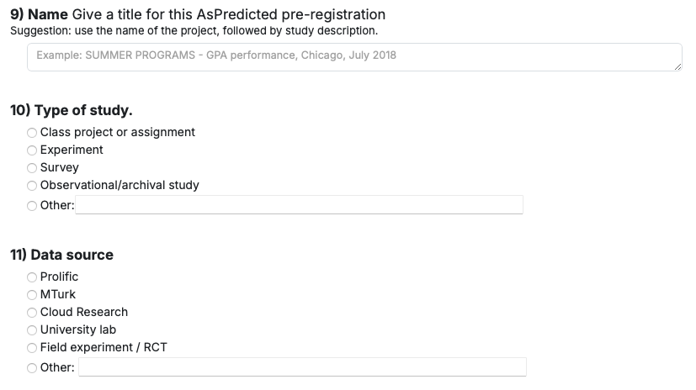
Example for https://aspredicted.org (4/4)

Slide 26
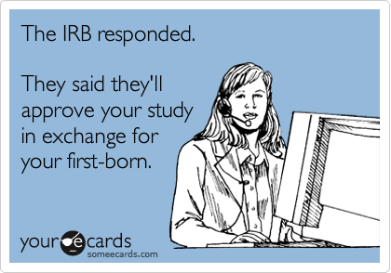
Good Research Practices (ALLEA, 2023)
4. Safeguards
Respect isn’t a sentiment; it’s a set of safeguards.

Slide 27
Good Research Practices (ALLEA, 2023)
4. Safeguards
Comply with relevant codes/guidelines/regulations.
Handle participants/subjects (human/animal/cultural/environmental) with respect and care.
Actively assess risks/harms and mitigate negative impacts.
Treat ethics review as paperwork rather than risk management.
Assume “it’s just survey data, so no harm possible”.

Slide 28
Ethical Approval for Studies Involving Human Participants
CERSUB
Comitato
Etico
per la Ricerca
con Soggetti
Umani
in campo non Biomedico

Slide 29
Ethical Approval for Studies Involving Human Participants
CERSUB
https://www.cersub.unina.it
Forms and instructions

Slide 30
If your study involves human participants, it should comply with GDPR (General Data Protection Regulations) and the Helsinki Declaration. Some core principles:
Respect and Autonomy
• Informed, voluntary participation
• Valid GDPR consent for data processing
• Right to withdraw at any time (without penalty)
Risk–Benefit and Data Minimisation
• Minimise risks, burden, and intrusion
• Collect only data that are strictly necessary
Scientific Purpose and Integrity
• Clear protocol and legitimate research aims
• Use data only for declared (or compatible) purposes
Privacy, Confidentiality, and Security
• Protect identity and sensitive data
• Pseudonymise or anonymise whenever possible
• Secure storage and controlled access

Slide 31
Materials:
See https://califano.xyz/ri

