Slide 1
Research Integrity:
Principles and Practices for Responsible Research
3
Giovanbattista Califano, PhD
giovanbattista.califano@unina.it
https://califano.xyz/ri

Slide 2
Principles (ALLEA, 2023)
Reliability in ensuring the quality of research, reflected in the design, methodology, analysis, and use of resources.
Honesty in developing, undertaking, reviewing, reporting, and communicating research in a transparent, fair, full, and unbiased way.
Respect for colleagues, research participants, research subjects, society, ecosystems, cultural heritage, and the environment.
Accountability for the research from idea to publication, for its manage­ment and organisation, for training, supervision, and mentoring, and for its wider societal impacts.

Slide 3
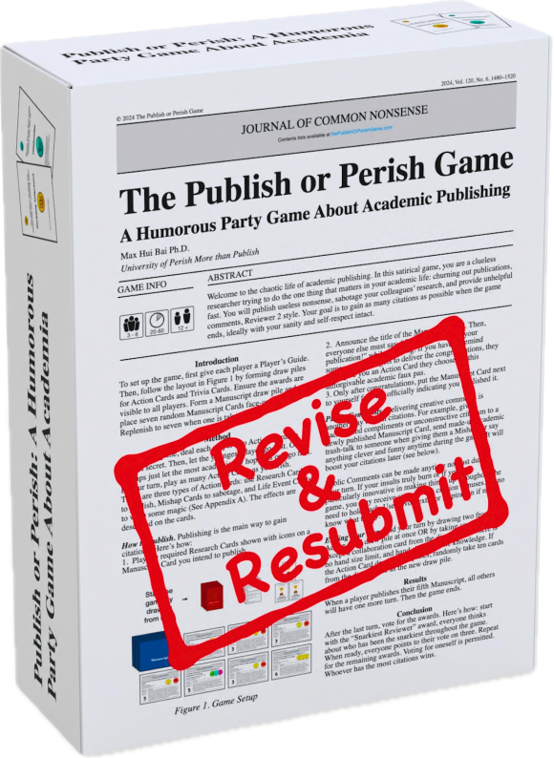
Good Research Practices (ALLEA, 2023)
1. Research Environment
If the environment rewards shortcuts, shortcuts will happen.

Slide 4
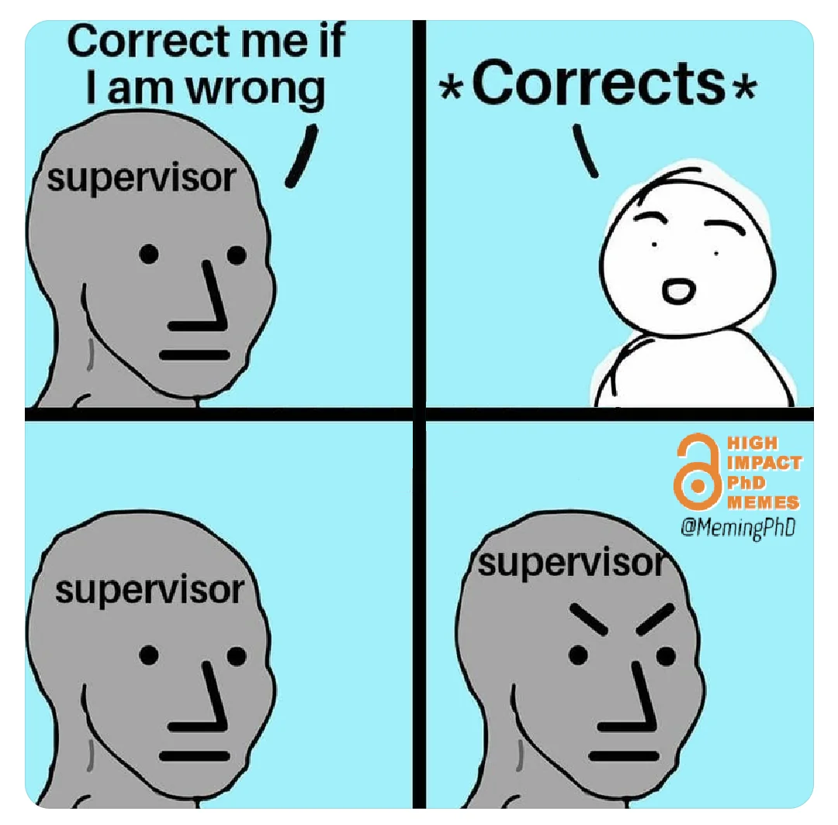
Good Research Practices (ALLEA, 2023)
2. Training, Supervision, and Mentoring
Training isn’t optional; it’s part of research quality control.

Slide 5
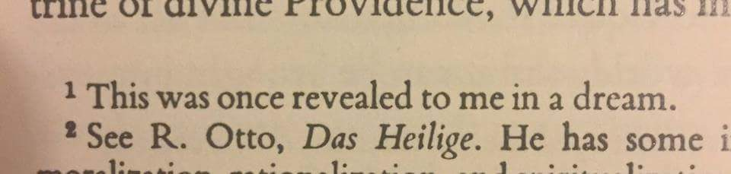
Good Research Practices (ALLEA, 2023)
3. Research Procedures
If you can’t explain it, you can’t defend it.

Slide 6
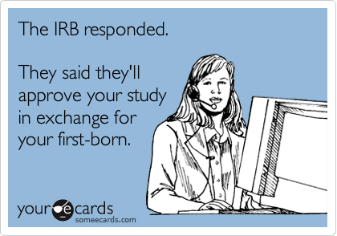
Good Research Practices (ALLEA, 2023)
4. Safeguards
Respect isn’t a sentiment; it’s a set of safeguards.

Slide 7
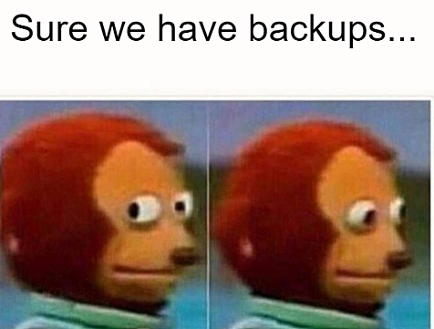
Good Research Practices (ALLEA, 2023)
5. Data Practices and Management
No stewardship = no credibility.

Slide 8


Good Research Practices (ALLEA, 2023)
5. Data Practices and Management
Ensure stewardship/curation/preservation of data + metadata + protocols + code + software for a stated period.
Apply “as open as possible, as closed as necessary” + FAIR when appropriate.
Treat datasets/code as citable research outputs.
Keep the “final dataset” on one laptop / one folder called FINAL_FINAL2.
Share data without clear access rules/permissions.

Slide 9
What is FAIR?
Findable
Use persistent identifiers, rich metadata and register (meta)data in searchable resources.
Accessible
Retrieve data via open, standardised protocols; ensure metadata stay accessible even when the data are withdrawn.
Interoperable
Use shared languages and vocabularies; include qualified references to link related datasets.
Reusable
Provide rich metadata, explicit licences, provenance and meet community standards.

Slide 10
What is OPEN ACCESS?
Open access refers to scholarly research outputs that are freely available online to anyone, without financial, legal, or technical barriers, and that can be read, downloaded, and shared without requiring payment or subscription.
Open access is not necessarily FAIR
(and vice versa)

Slide 11
Open Access Models
Green
Deposit peer‑reviewed articles in repositories after an embargo; final publisher formatting may be absent.
Gold
Immediate open access on the journal website; often financed by Article Processing Charges (APCs).
Hybrid
Subscription journals offer optional open access for individual articles at an extra cost (sometimes called double dipping).
Diamond
Journals free for both authors and readers, supported by institutions or consortia.
Black
Unauthorised platforms providing illicit access to paywalled articles (e.g. Sci‑Hub).

Slide 12
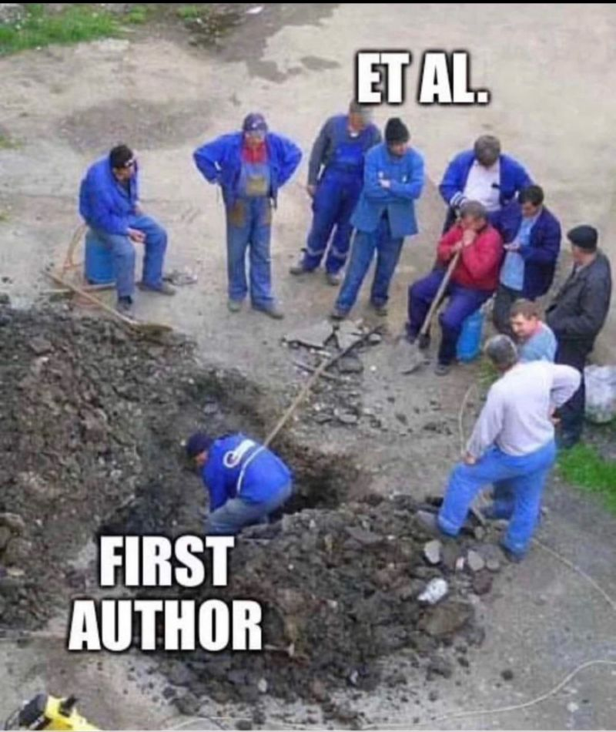
Good Research Practices (ALLEA, 2023)
6. Collaborative Working
Collaboration needs contracts (even informal ones).

Slide 13
Good Research Practices (ALLEA, 2023)
6. Collaborative Working
Agree at the outset on goals + communication plan (and revisit as needed).
Agree at the outset on integrity standards, laws, IP protection, conflict handling.
Require team consent on submissions/public dissemination.
Start sharing data/materials before clarifying IP, roles, and jurisdictions.
Surprise coauthors with a submitted manuscript.

Slide 14
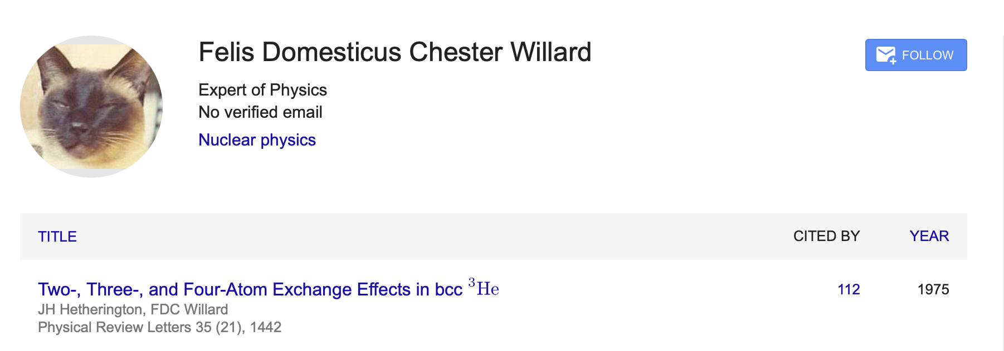
Good Research Practices (ALLEA, 2023)
7. Publication, Dissemination, and Authorship
Authorship is responsibility, not a reward.

Slide 15
Good Research Practices (ALLEA, 2023)
7. Publication, Dissemination, and Authorship
Agree on author order and use clear authorship criteria + responsibility for content.
Include an Author Contribution Statement where possible.
Disclose financial/non-financial conflicts and sources of support.
Correct/retract promptly when needed; value negative results too.
Gift/ghost authorship, or “add the boss to be safe” (Misaligns accountability).
Overclaim certainty in outreach; hide uncertainty/limits of evidence.

Slide 16
From authorship to contributorship
CRediT taxonomy
(Contributor Role Taxonomy)

Slide 17
Term | Definition
Conceptualization | Ideas; formulation or evolution of overarching research goals and aims
Methodology | Development or design of methodology; creation of models
Software | Programming, software development; designing computer programs; implementation of the computer code and supporting algorithms; testing of existing code components
Validation | Verification, whether as a part of the activity or separate, of the overall replication/reproducibility of results/experiments and other research outputs
Formal analysis | Application of statistical, mathematical, computational, or other formal techniques to analyse or synthesize study data
Investigation | Conducting a research and investigation process, specifically performing the experiments, or data/evidence collection
Resources | Provision of study materials, reagents, materials, patients, laboratory samples, animals, instrumentation, computing resources, or other analysis tools
Data curation | Management activities to annotate (produce metadata), scrub data and maintain research data (including software code, where it is necessary for interpreting the data itself) for initial use and later re-use

Slide 18
Term | Definition
Writing – original draft | Preparation, creation and/or presentation of the published work, specifically writing the initial draft (including substantive translation)
Writing – review and editing | Preparation, creation and/or presentation of the published work by those from the original research group, specifically critical review, commentary or revision – including pre- or post-publication stages
Visualization | Preparation, creation and/or presentation of the published work, specifically visualization/data presentation
Supervision | Oversight and leadership responsibility for the research activity planning and execution, including mentorship external to the core team
Project administration | Management and coordination responsibility for the research activity planning and execution
Funding acquisition | Acquisition of the financial support for the project leading to this publication

Slide 19
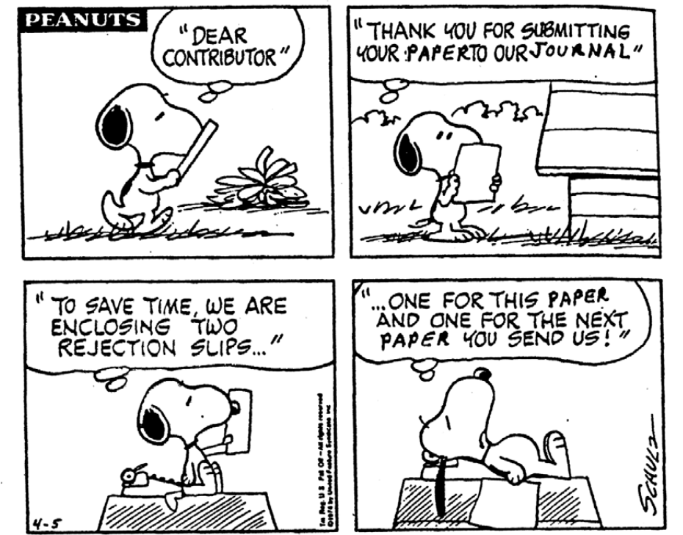
Good Research Practices (ALLEA, 2023)
8. Reviewing and Assessment
Fair evaluation is part of integrity.

Slide 20
Good Research Practices (ALLEA, 2023)
8. Reviewing and Assessment
Review/assess transparently and justifiably.
Declare conflicts of interest; withdraw when needed.
Maintain confidentiality; don’t reuse others’ ideas/data without permission.
Support assessment beyond raw metrics; include openness, inclusiveness, collaboration where relevant.
Use confidential manuscripts/grants as “free literature review”.
Hide the use of AI tools in assessment/review processes.

Slide 21
Test time ☺

